Slide 1
Mehveen Zafar
Cosc201101082
BSCS-8B
Instructor: Dr. Saleem Ullah

Slide 2


Slide 3
Contents
What is Firebase?
Features of firebase
How to develop high quality apps?
How to grow your user base?
How to earn more money?

Slide 4
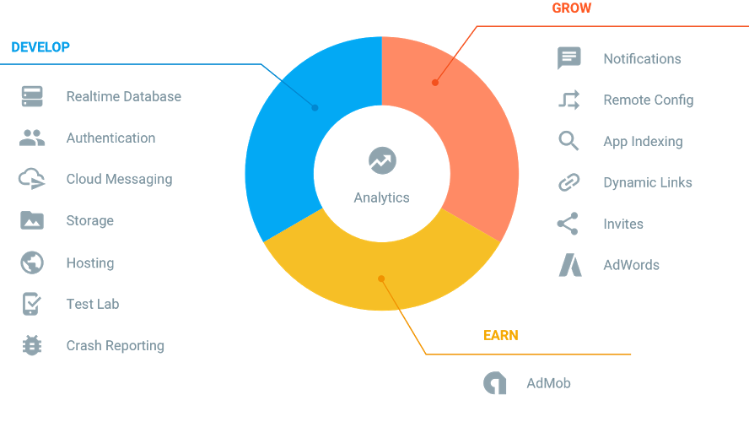
What is Firebase?
Realtime Application Platform

Slide 5


Features of firebase
Forget about infrastructure
Make smart, data-driven decisions

Slide 6
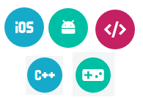


Features of firebase
Work across platforms
Free to start, scale with ease
Get free support

Slide 7

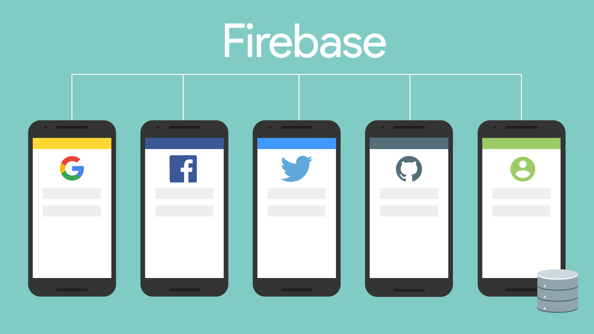

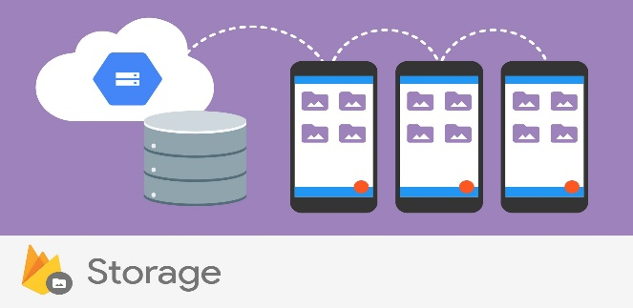
DEVELOP
Realtime Database
Store and sync app data in
realtime
Authentication
Reduce friction with robust
authentication
Cloud Messaging
Deliver and receive messages
across platforms reliably
Storage
Store files with ease

Slide 8

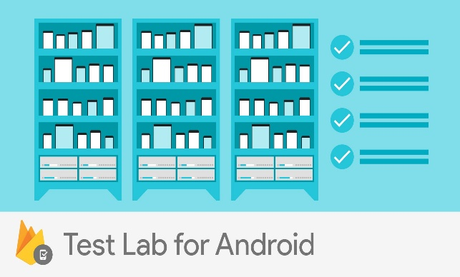

DEVELOP
Hosting
Deliver web content faster
Test Lab
Test in the lab, not on your
users
Crash Reporting
Keep your app stable

Slide 9
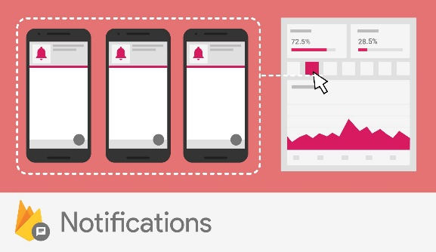
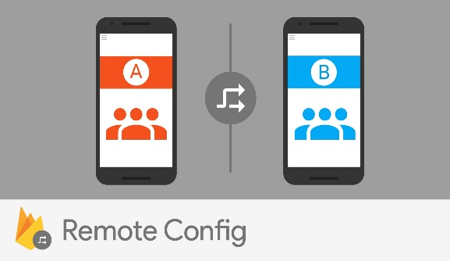
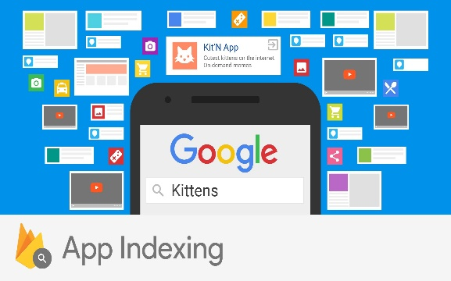
GROW
Notifications
Engage with users at the right
moment
Remote Config
Customize your app on the fly
App Indexing
Drive organic search traffic to
your app

Slide 10



GROW
Dynamic Links
Send users to the right place
inside your app
Invites
Empower your users to share
your app

Slide 11
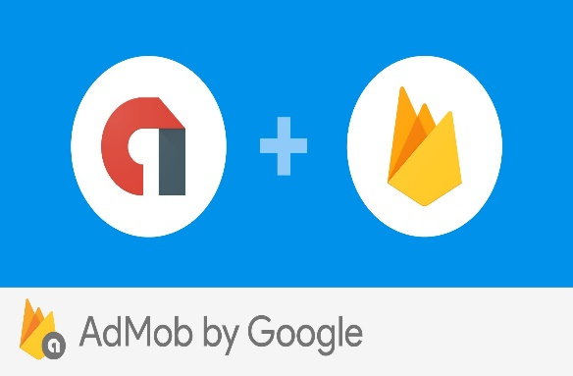
EARN
AdMob
Monetize through engaging
ads

Slide 12

Thank You

